Slide 1

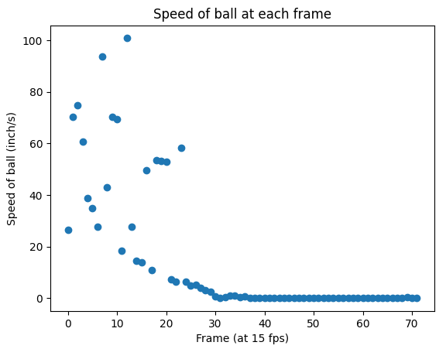
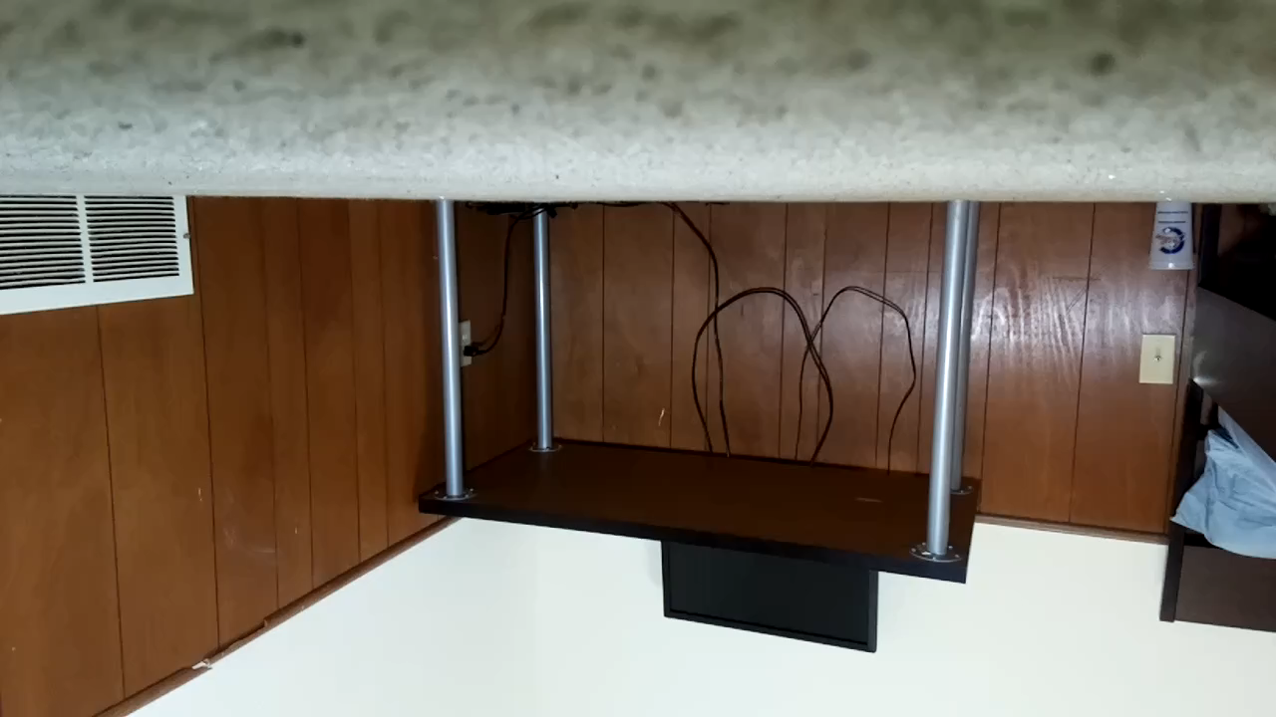
Tracking Speed of Ball through Scene
Ryan Strotman

Slide 2
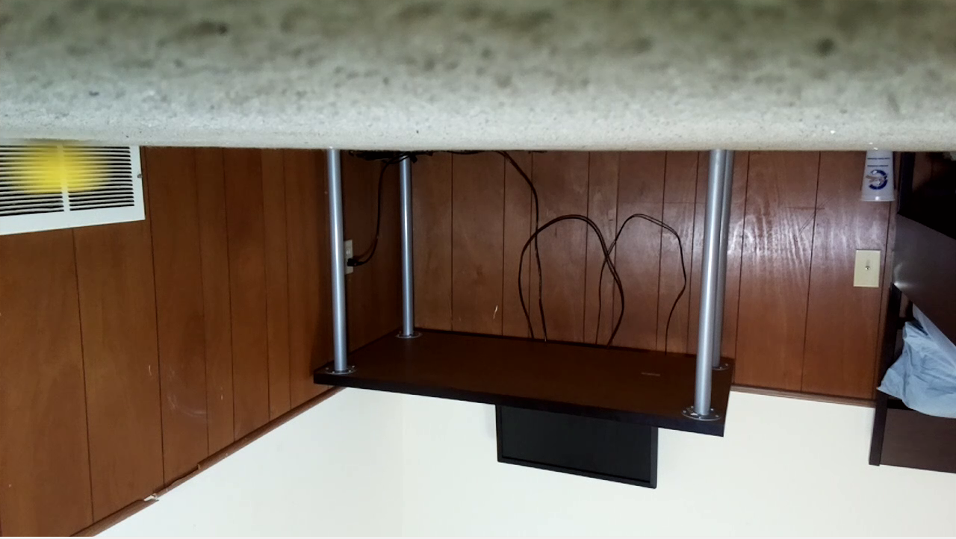
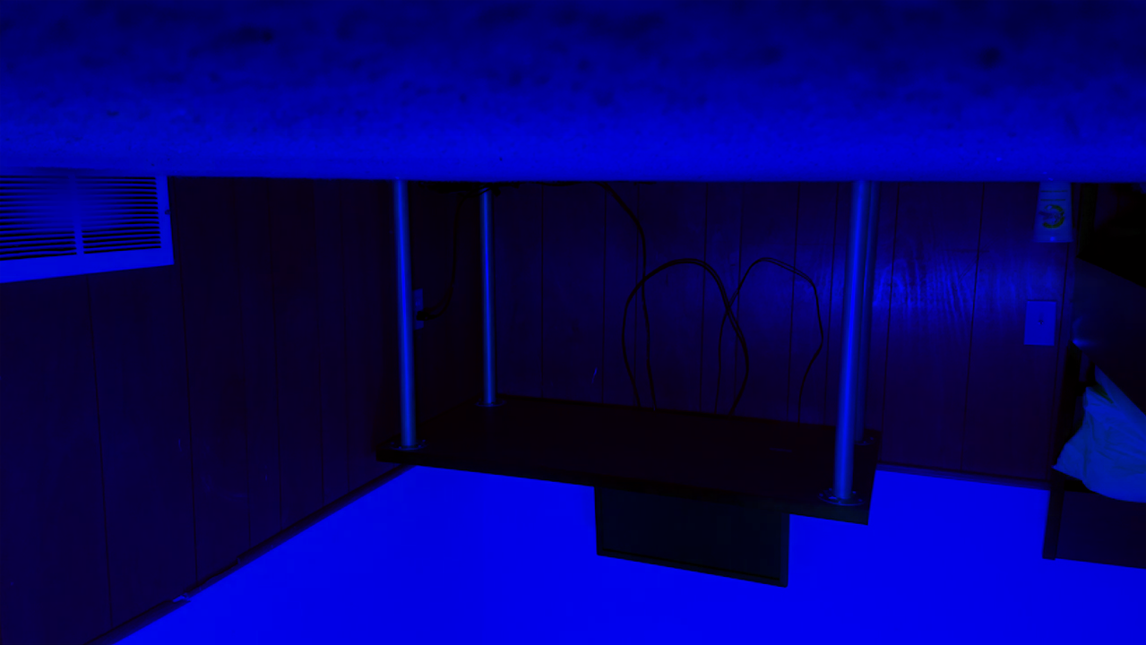



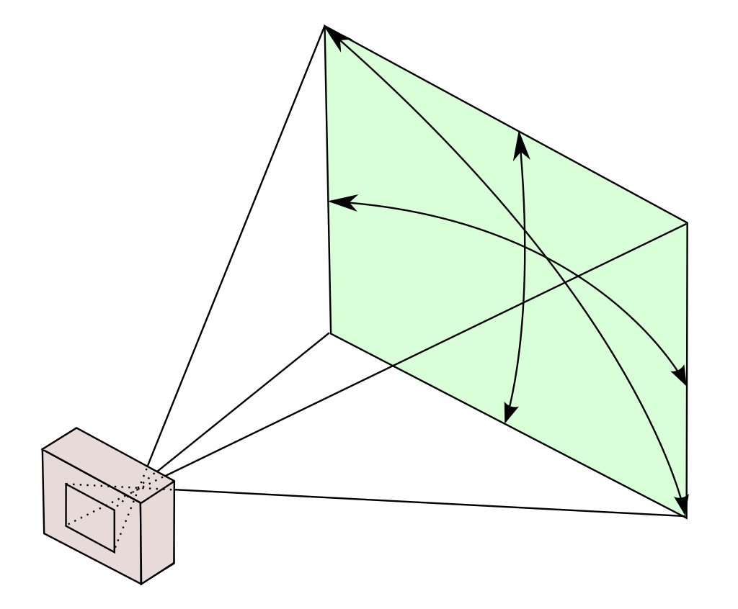
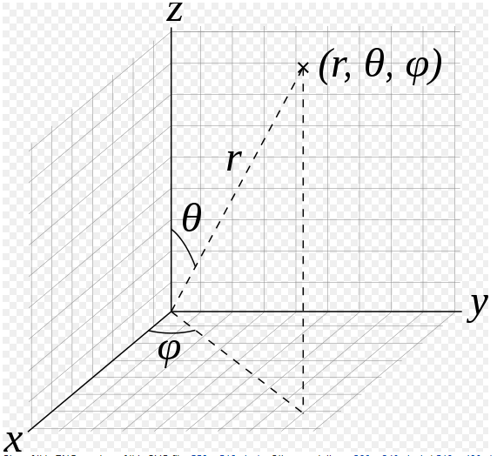
How was it done?
Raw RGB Image
YIQ Image
Raw Image Difference
Largest Connected Component
Diameter, X-Centroid, and Y-Centroid
Compute Radius, Theta, and Phi
Convert from Polar to Cartesians

Slide 3
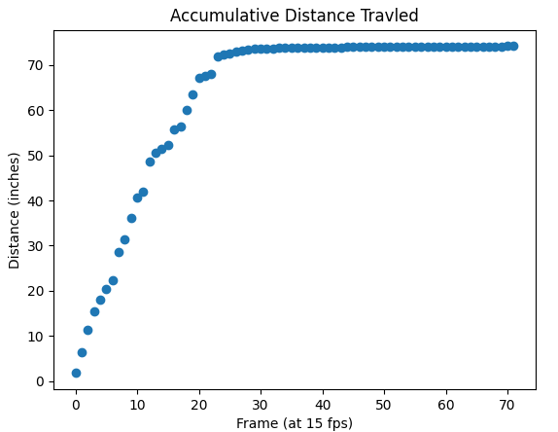
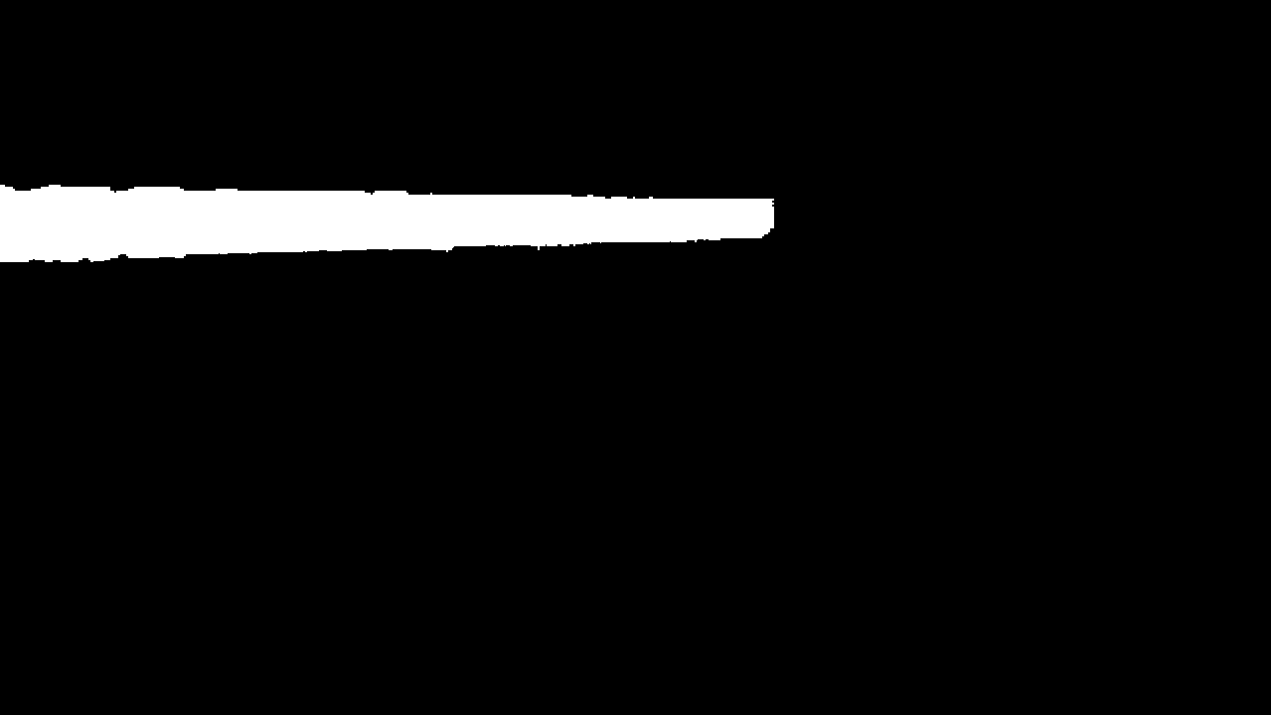
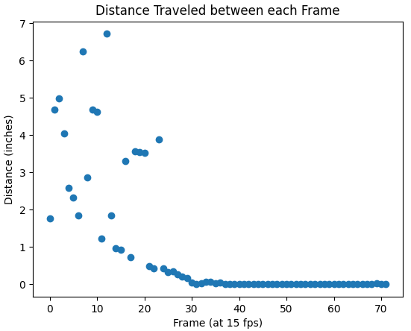
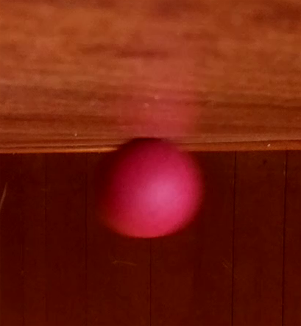

Results
Problems encountered
Lossless video files
Shadows/Reflections
Motion Blur
What is next?
Evaluate in real time
More robust to Shadows and reflections
Handle faster objects
Better function for converting to real x, y, z positions
Accumulative distance traveled
74.2 inches
Distance from First to Last frame
52.7 inches

